Slide 1
Using Transfer Learning Models for Identifying Date Palm Leaf Diseases and Recommending Pesticides
BATCH -134
Presented by
211FA04444
211FA04440
221LA04011
Guided : T. Narasimha Rao
Assistant Professor
Department of cse

Slide 2
CONTENTS
Abstract
Problem Identification
Objective
Dataset Description
Data Pre-processing
Methodology
Model Comparison Table
Results
References

Slide 3
ABSTRACT
Date palm leaf diseases are harmful that can damage leaves, reduce tree health, and affect overall crop yield.
Detecting date palm leaf diseases early is crucial to protect the trees and ensure proper treatment.
The main goal of this project is using a Transfer Learning models that can identify and classify date palm leaf identification and recommend appropriate pesticides.
It will detect different types of leaf diseases, such as:
healthy, brown spots, white scale, Bug, Honey, Healthy2, Dubas

Slide 4
PROBLEM IDENTIFICATION
Why Traditional Methods for Date Palm Leaf Disease Detection Fail?
❌ Diseases may go unnoticed until significant damage is done.
❌ Limited ability to detect new or unknown diseases without expert knowledge.
❌ Previous models do not suggest pesticides for treatment.
Why Use Transfer Learning for Date Palm Leaf Disease Detection?
✔️ Transfer Learning models can learn patterns from vast datasets of leaf images.
✔️ This model takes less time for predict the disease
✔️ Provides faster and more accurate detection compared to manual inspection, ensuring timely treatment.

Slide 5
OBJECTIVES
Main Goal:
Using a Transfer Learning models to detect and classify date palm leaf diseases and recommend appropriate pesticides.
Sub-goals:
Collect and pre-process leaf image data for disease detection.
Extract important features from leaf images that indicate the presence of diseases.
Compare different deep learning models and identify the most accurate one for disease classification.
Optimize the model for real-time disease detection and pesticide recommendation.
It suggest suitable pesticides for treatment.

Slide 6
DATASET DESCRIPTION
This dataset is used to detect date palm leaf diseases by analyzing images of leaf conditions. It contains both healthy and diseased leaf samples, allowing us to train deep learning models to classify and detect diseases effectively.
Dataset Name: Date Palm Leaf Purpose: Identify leaf diseases based on image features and recommend appropriate pesticide treatments.
My dataset consists of 5630 samples
Healthy: 1203 images
Brown Spots: 480 images
White Scale: 958 images
Bug : 600 images
Honey: 810 images
Healthy2: 810 images
Dubas: 800 images

Slide 7
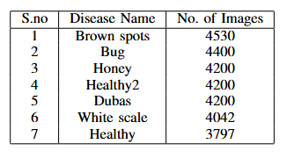
DATA PRE-PROCESSING
Before training deep learning models, we prepare the dataset with the following steps:
✔ Resize Images – Standardize the image size (e.g., 224x224 pixels). ✔ Remove Duplicates – Eliminate repeated images to prevent overfitting. ✔ Label Encoding – Convert leaf conditions ('Bug': 0, 'Dubas': 1, 'Healthy2': 2, 'Honey': 3, 'brown spots': 4, 'healthy': 5, 'white scale': 6) ✔ Data Augmentation – Apply transformations (rotation, flipping, zooming, cropping) to increase diversity. ✔ Split Dataset – Divide data into 70% training, 10% validation, and 20% testing sets.
After Data Augmentation

Slide 8
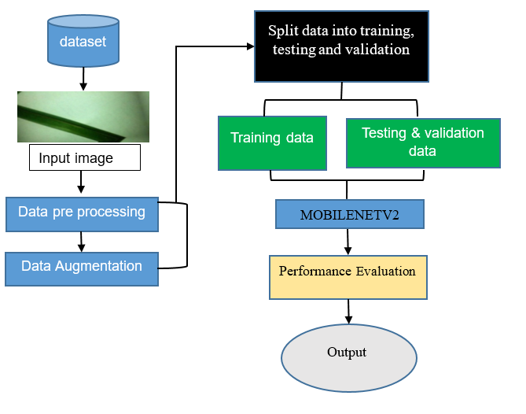
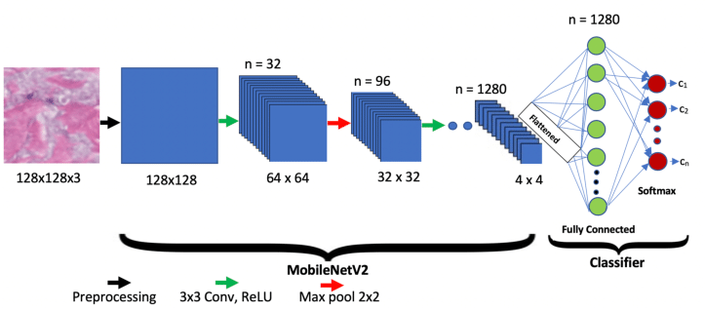
PROPOSED MODEL

Slide 9
METHODOLOGY
Data Splitting:
70% for training, 10% for validation, and 20% for testing.
Feature Selection:
Focused on relevant image features like leaf texture, color, and symptoms.
Model Training:
Trained Resent , Mobile net, and Efficient net models.
Model Testing & Evaluation:
Tested models for accuracy, precision, recall, and F1-score.
Final Model Selection:
Mobile net model with 96% accuracy was selected as the final model.
Disease Classification and Pesticide Recommendation: The system classifies the disease from the leaf image and provides automated pesticide recommendations based on the detected disease.

Slide 10
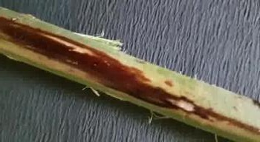
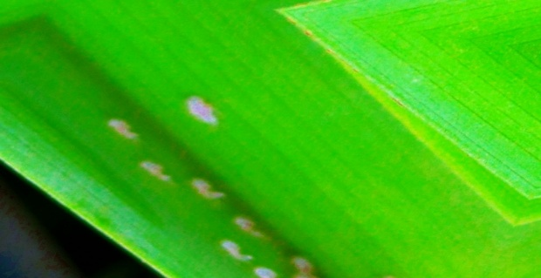
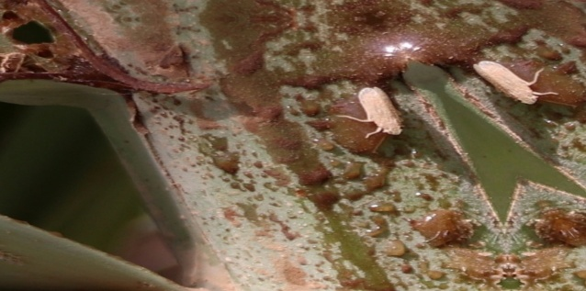
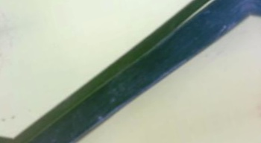

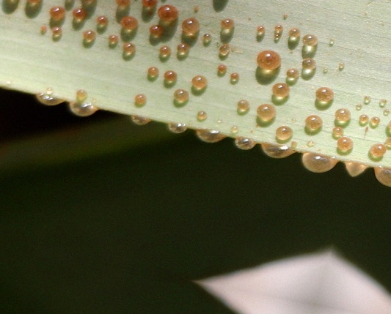

DATASET
Brown spots
Bug
Dubas
Honey
White scale
Healthy
Healthy2

Slide 11



PERFORMANCE METRIX
Accuracy: The proportion of correct predictions (both true positives and true negatives) out of all predictions made.
Precision: The proportion of true positives out of all predicted positives, indicating how accurate positive predictions .
Recall: The proportion of true positives out of all actual positives, showing how well the model identifies positive instances.

Slide 12
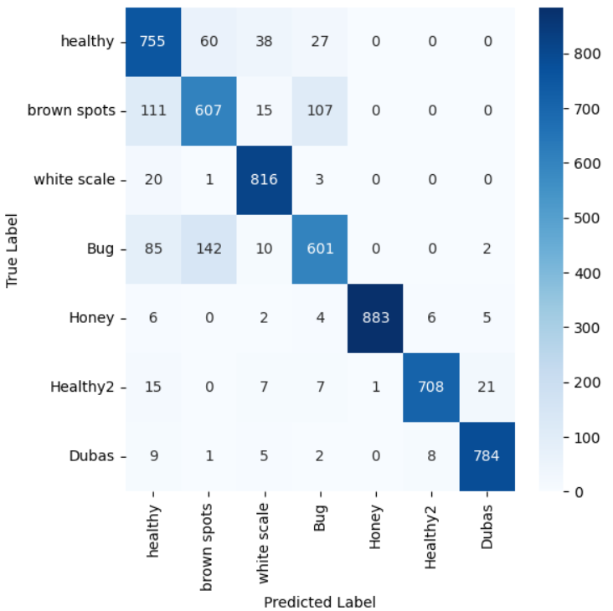

F1-Score: The harmonic mean of precision and recall, balancing the trade-off between the two metrics.
Support :The actual number of true instances in the dataset for that class

Slide 13
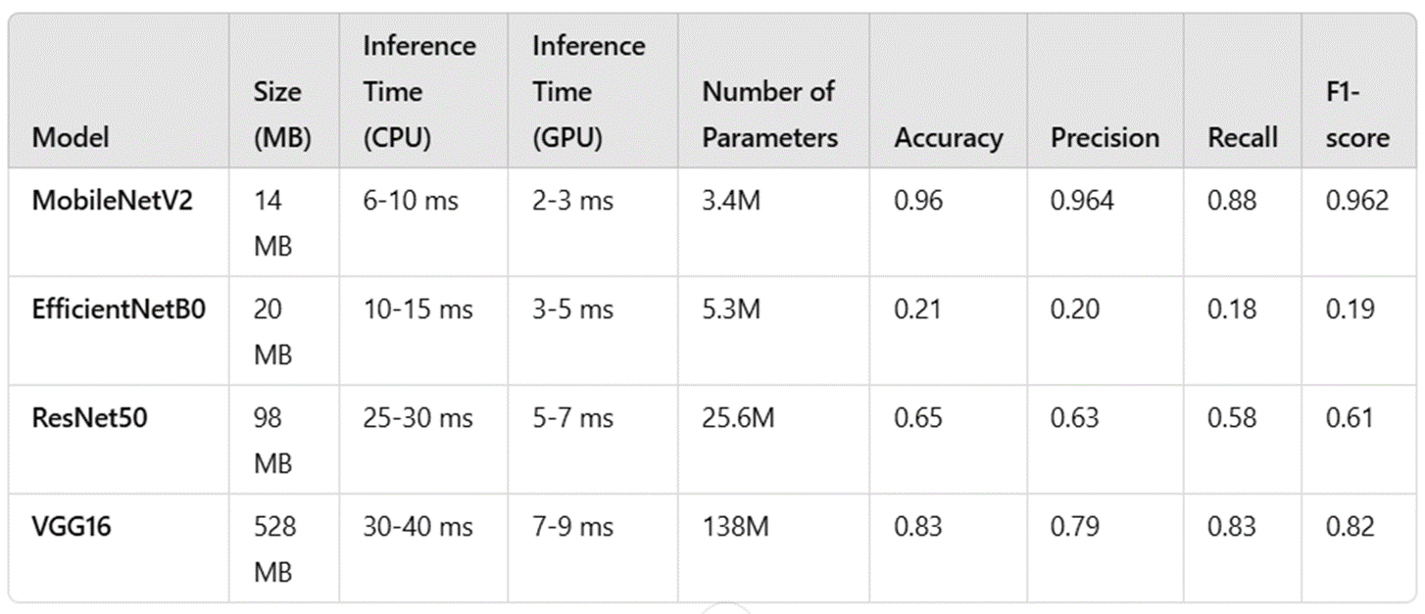
COMPARISON TABLE

Slide 14
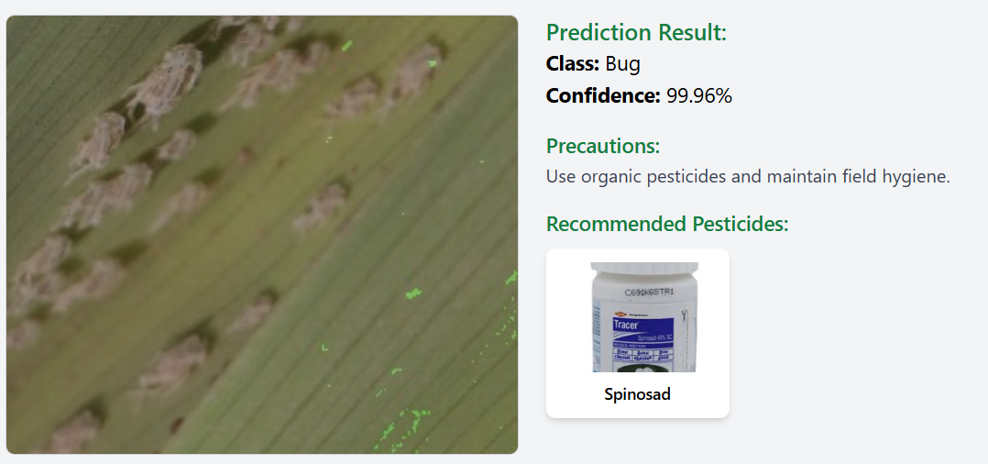
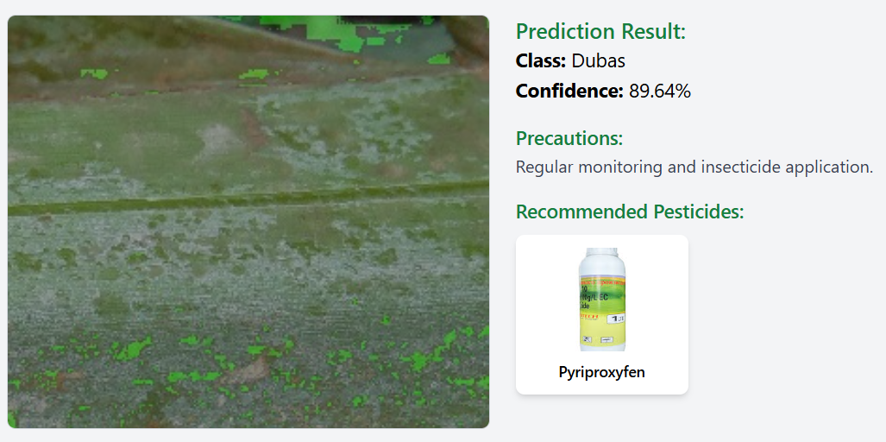
RESULTS

Slide 15
CONCLUSION
The system leverages MobileNetV2, a highly efficient transfer learning model, to achieve 94% accuracy in date palm disease detection. This model was selected due to its superior performance in accuracy, inference speed, and resource efficiency. By integrating MobileNetV2, the system ensures precise disease identification and provides real-time pesticide recommendations, optimizing pesticide usage based on specific disease conditions.

Slide 16
REFERENCES
S. Savaş, "Application of Deep Ensemble Learning for Palm Disease Detection in Smart Agriculture," Heliyon, vol. 10, 2024, e37141.
A. Mazin and H. Almayaly, "The infected date palm leaves by Dubas insects dataset," University of Karbala, 2022.
G. Huang, Z. Liu, L. Van Der Maaten, and K. Q. Weinberger, "Densely Connected Convolutional Networks for date palm leaf disease detection.
K. He, X. Zhang, S. Ren, and J. Sun, "Deep Residual Learning for date palm disease identification.

